Slide 1
Employee Data Analysis using Excel
STUDENT NAME:PAVITHRA R
REGISTER NO: 312214570/DA37031A0BF31608A6D4AC8451135F60
DEPARTMENT: DEPARTMENT OF COMMERCE
COLLEGE: St Thomas College Of Arts & Science

Slide 2
PROJECT TITLE Visualizing Employee Attendance Trend with Excel charts

Slide 3


AGENDA
Problem Statement
Project Overview
End Users
Our Solution and Proposition
Dataset Description
Modelling Approach
Results and Discussion
Conclusion
3/21/2024 Annual Review

Slide 4

PROBLEM STATEMENT
To effectively visualize and analyze employee attendance data over time using Excel charts.
The goal is to identify patterns, trends, and anomalies in attendance
which can aid in decision-making regarding workforce management and policy adjustments

Slide 5

PROJECT OVERVIEW
To analyze and visualize employee attendance data using Excel charts to identify trends, patterns, and areas for improvement.

Slide 6

WHO ARE THE END USERS?
HR Managers: To monitor attendance patterns, track absences, and ensure compliance with company policies .
Team Leaders/Supervisors: To manage day-to-day staffing needs, identify attendance issues, and address productivity concerns.
Operation Managers: To optimize resource allocation and adjust staffing levels based on attendance trends.
Finance Departments: To analyze the financial impact of attendance patterns, such as overtime costs or productivity losses.

Slide 7

OUR SOLUTION AND ITS VALUE PROPOSITION
Our solution offers a comprehensive approach to visualizing employee attendance trends using Excel charts.
By integrating data analysis with clear graphical representations, we make it easier for organizations to monitor attendance patterns and identify trends over time.

Slide 8
Dataset Description Employee= KAGGLE 26-Features 9-Features Emp Id- Number Name Text Emp- Type Current Employee Rating- Number Gender- Male Female Employee Rating -Number

Slide 9

THE "WOW" IN OUR SOLUTION
=IFS(Z8>=5,”VERY HIGH”,Z8>=4,”HIGH”,Z8>=3,”MED”,TRUE,”LOW”)
3/21/2024 Annual Review
9

Slide 10
MODELLING
Dynamic Charts: Use line charts or area charts to show trends over time.
These can help you easily identify patterns and fluctuations in attendance .
Conditional Formatting: Highlight specific data points or ranges using color scales or data bars.
For instance, you might use a gradient to show attendance levels, with high attendance in green and low in red.
10

Slide 11
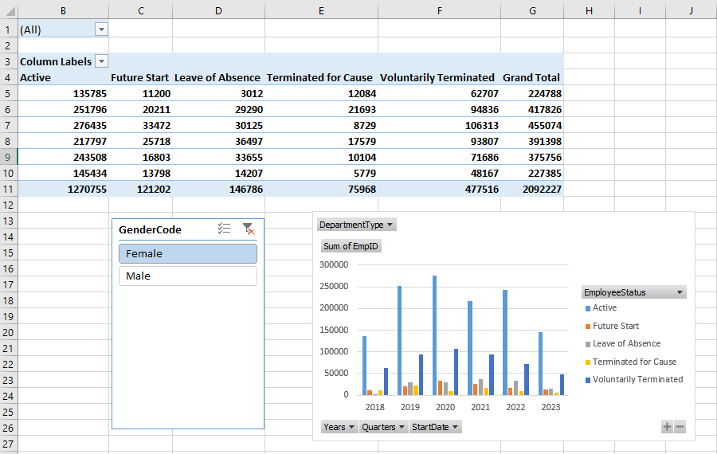
RESULT
Visualizing Employee Attendance Trend with Excel charts

Slide 12
RESULTS
Visualizing Employee Attendance Trend with Excel charts
12

Slide 13
Conclusion
In conclusion, effectively visualizing employee attendance trends in Excel involves a strategic approach to data organization and presentation. By using pivot tables and dynamic charts such as line, column, and stacked column charts, you can clearly illustrate attendance patterns, compare different data points, and highlight trends over time. Enhancing these visualizations with trend lines , conditional formatting, and interactive dashboards further improves clarity and usability, enabling stakeholders to make informed decisions and identify areas needing attention. This approach not only simplifies complex data but also provides actionable insights into attendance management.

